Slide 1
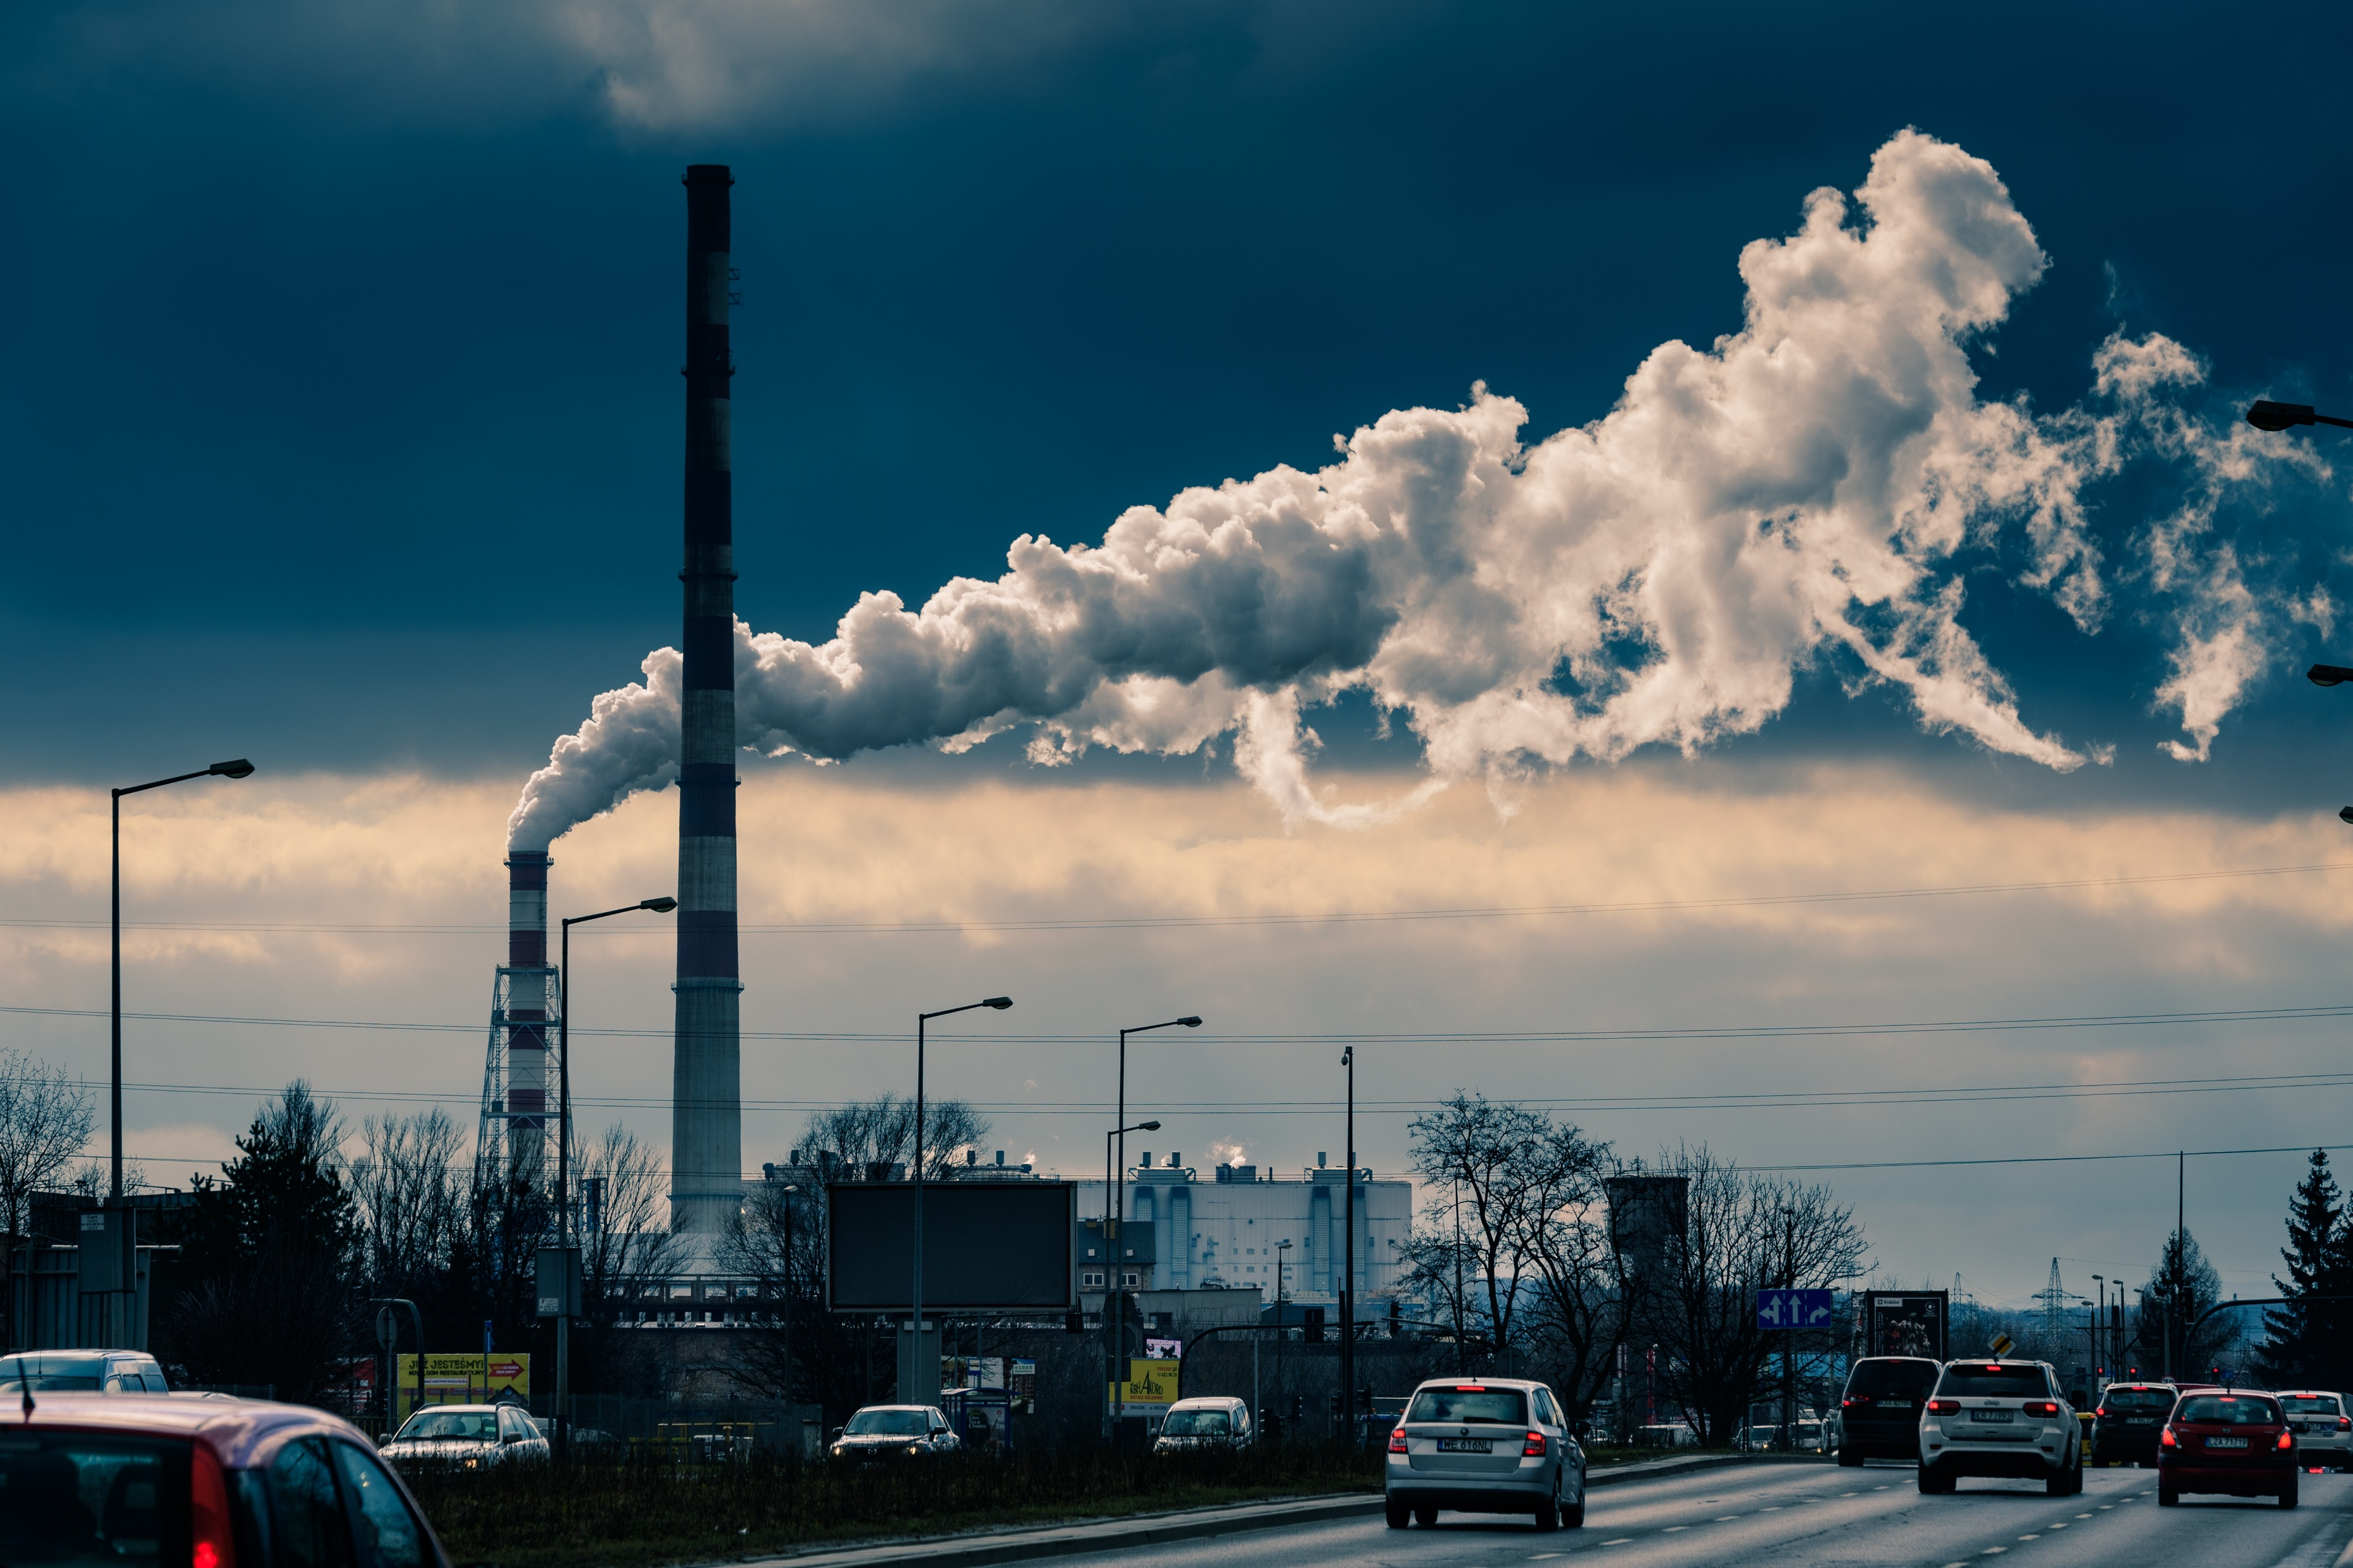
AIR QUALITY MANAGEMENT
PROJECT DEFINITION :
The project involves integrating IoT sensors into air quality measurement to monitor pollution free,health care, realtime monitoring,energy efficiency.The goal is to help protect human health and the environment from the harmful effects of air pollution.The project includes project objectives,IoT device setup, platform development, code implementation and real-time air quality monitoring system which raise public awareness about air quality and health impact.

Slide 2
SUBTITLES:
PROJECT OBJECTIVES
IOT DEVICE SETUP FOR AIR QUALITY
PLATFORM DEVELOPMENT
CODE IMPLEMENTATION
SCREENSHOTS OF IOT DEVICES AND DATA SHARING PLATFORM
PUBLIC AWARENESS AND EDUCATION
SUGGESTED GOAL, OBJECTIVES AND POLICIES/STRATEGIES

Slide 3
PROJECT OBJECTIVES :
In an IoT-based air quality project, the objectives generally revolve around leveraging Internet of Things technologies to enhance air quality monitoring and management. Some specific project objectives might include:
Sensor Deployment: Deploying a network of IoT sensors to measure key air quality parameters, such as particulate matter (PM), nitrogen dioxide (NO2), ozone (O3), and others.
Alert Systems: Developing automated alert systems that notify relevant stakeholders or the public when air quality levels exceed predefined thresholds.
Real-time Monitoring: Establishing a real-time monitoring system to collect continuous and instantaneous data on air quality.
Data Transmission: Implementing efficient and secure data transmission protocols to relay information from sensors to a central database or cloud platform.
Data Analytics: Employing data analytics and machine learning algorithms to analyze the collected data, identify patterns, and predict air quality trends.

Slide 4
Integration with Existing Systems: Integrating IoT air quality data with existing environmental monitoring systems and databases for a comprehensive view.
Community Engagement: Involving local communities and stakeholders in the deployment and maintenance of IoT sensors, fostering a collaborative approach to address air quality issues.
Energy Efficiency: Designing IoT devices and systems with a focus on energy efficiency to ensure sustainable and long-term operation.
Scalability: Creating a scalable infrastructure that can accommodate an increasing number of sensors and data points as the project expands User.
Interface: Developing user-friendly interfaces, such as dashboards or mobile apps, to present air quality information in an accessible way for both experts and the general public.
Feedback Mechanism: Establishing a feedback mechanism to gather insights from users and continuously improve the system based on their experiences and needs.
These objectives aim to harness the potential of IoT to provide timely, accurate, and actionable information for effective air quality management.

Slide 5
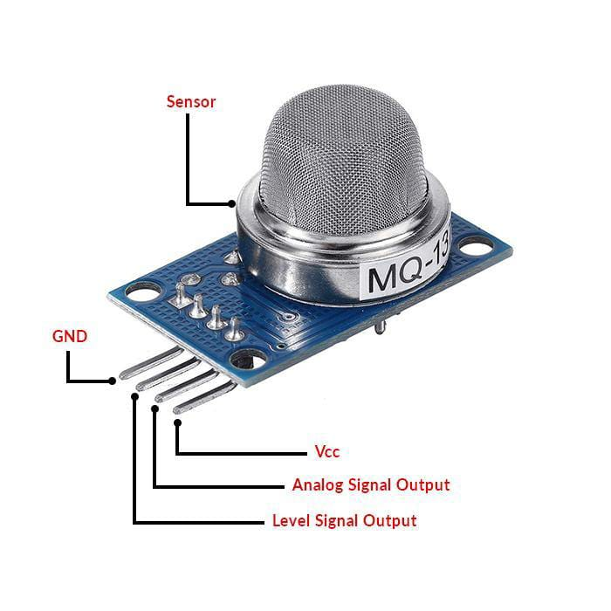
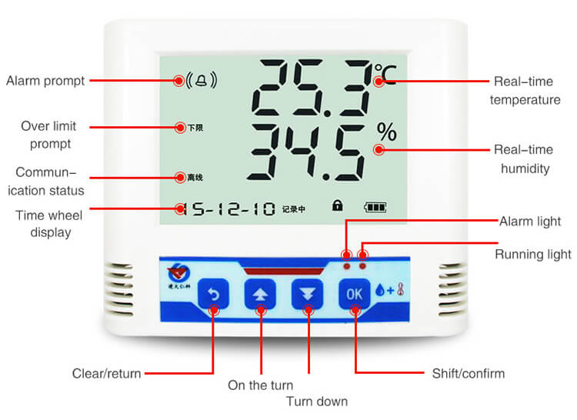
IOT DEVICE SETUP FOR AIR QUALITY:
1. Gas Sensors:
MQ Series Sensors:
These sensors are widely used for detecting gases such as carbon monoxide (MQ-7), methane (MQ-4), and others. They provide analog output proportional to the concentration of the gas.
2. Particulate Matter (PM) Sensors:
Sharp GP2Y Dust Sensors:
These sensors can measure the concentration of particulate matter in the air, helping to assess air quality.
3.Temperature and Humidity Sensors:
DHT Series Sensors:
These sensors measure both temperature and humidity, providing essential data for a comprehensive understanding of environmental conditions.

Slide 6
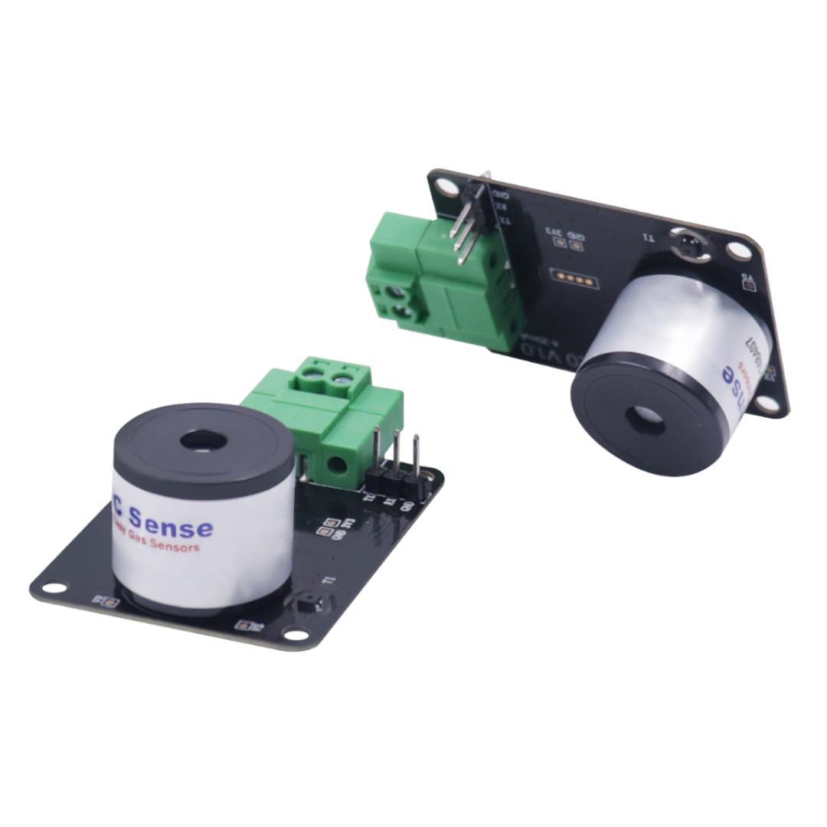
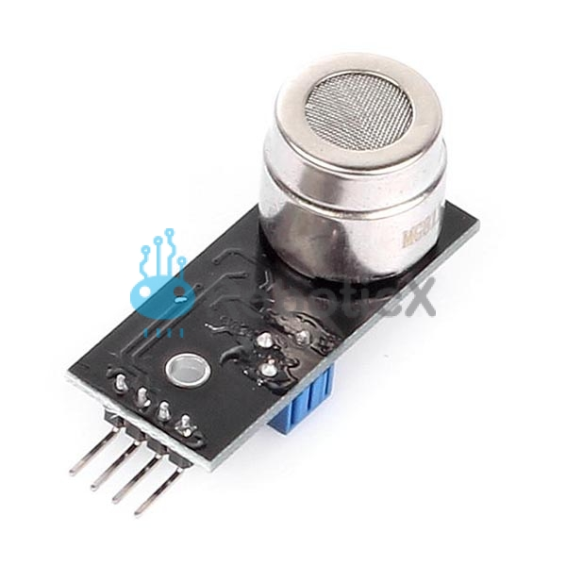
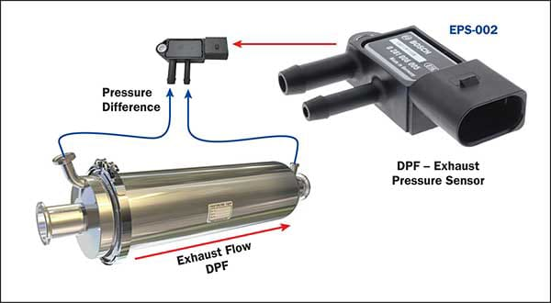
5. Ozone (O3) Sensors:
MiCS-5524 Gas Sensor:
This sensor can detect various gases, including ozone, and is commonly used in air quality monitoring systems.
4. Carbon Dioxide (CO2) Sensors:
MH-Z Series Sensors:
CO2 sensors are crucial for assessing indoor air quality. They measure the concentration of carbon dioxide in the
air.

Slide 7
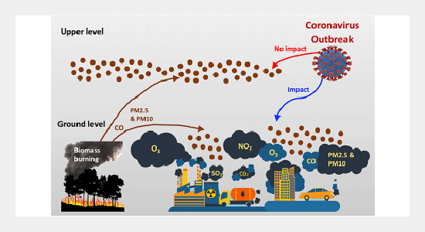
PLATFORM DEVELOPMENT :
Developing a platform for air quality in IoT involves integrating sensors to collect air quality data, utilizing a communication protocol like MQTT, and creating a user interface for data visualization. Consider scalability, real-time analytics, and security in your design.

Slide 8
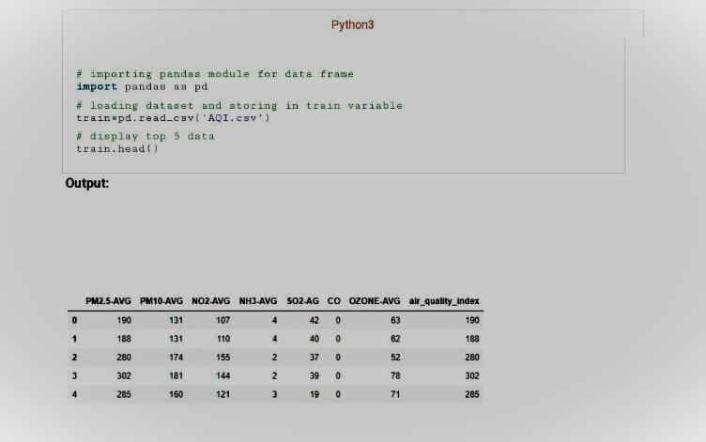
CODE IMPLEMENTATION :

Slide 9
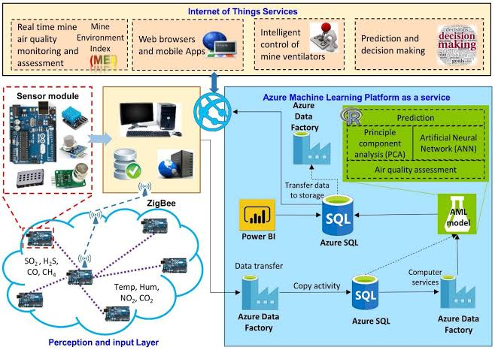
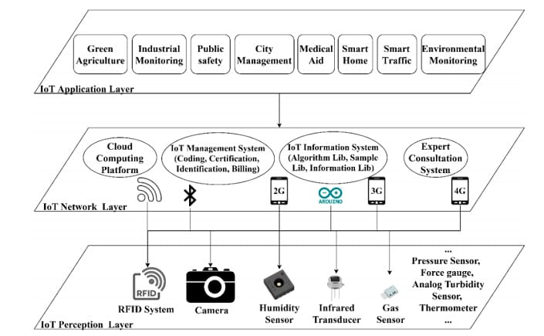
SCREENSHOTS OF IOT DEVICES AND DATA SHARING PLATFORM:

Slide 10
PUBLIC AWARENESS AND EDUCATION:
In Town Hall meetings held by the AQMD, residents throughout the South Coast basin
have asked how the public can become more involved in reducing local air pollution
impacts in their communities. Local governments are encouraged to invest in public
outreach activities and programs to build strong public awareness of regional and local air quality issues and health studies.
air quality issues and health studies. To foster greater community involvement and
support in developing public policy, local jurisdictions should consider the following
activities to improve awareness of air quality and environmental justice issues.
• identify an individual as a contact person for environmental justice issues.
• participate with the AQMD in Town Hall meetings to hear citizen concerns
regarding air quality and environmental justice.

Slide 11
SUGGESTED GOAL, OBJECTIVES AND POLICIES/STRATEGIES :
Goal 6 Greater public awareness of the changes in personal behavior
that can be chosen to minimize air pollution
Objective 6.1 Make air quality education a priority for the City’s effort to protect
public health and achieve state and federal clean air standards
Suggested Policies/Strategies Related to Public Awareness:
AQ 6.1.1 Provide regional and local air quality information on City’s website,
including links to the AQMD, CARB, USEPA and other environmental-
based internet sites.
AQ 6.1.2 Organize city-sponsored events on topics that educate businesses and the public about compliance with air quality regulations (e.g., alternative fuels and low polluting clean household products).
AQ 6.1.3 Work with school districts to develop air quality curricula for students.

Slide 12
THANK YOU
These are the topics of( phase -1)Air Quality Management.
Presented by :
Mohamed Ashraf Ali M
422621104026
University college of engineering
panruti

